Slide 1
Presentation on Scrum Board
GROUP MEMBERS ID & NAME
NAME | ID
1. Md. Reaz Uddin Chowdhury | 21-92155-3
2. Ummey Soaiba Yeasmin | 21-92158-3
3. Md. Tanvir Rahman | 22-92418-1
4. Akibur Rahman Akib | 22-92573-2
5. Sheuly Akter | 22-92609-2
6. Md. Rifat-Uz-Zaman | 22-92610-2

Slide 2
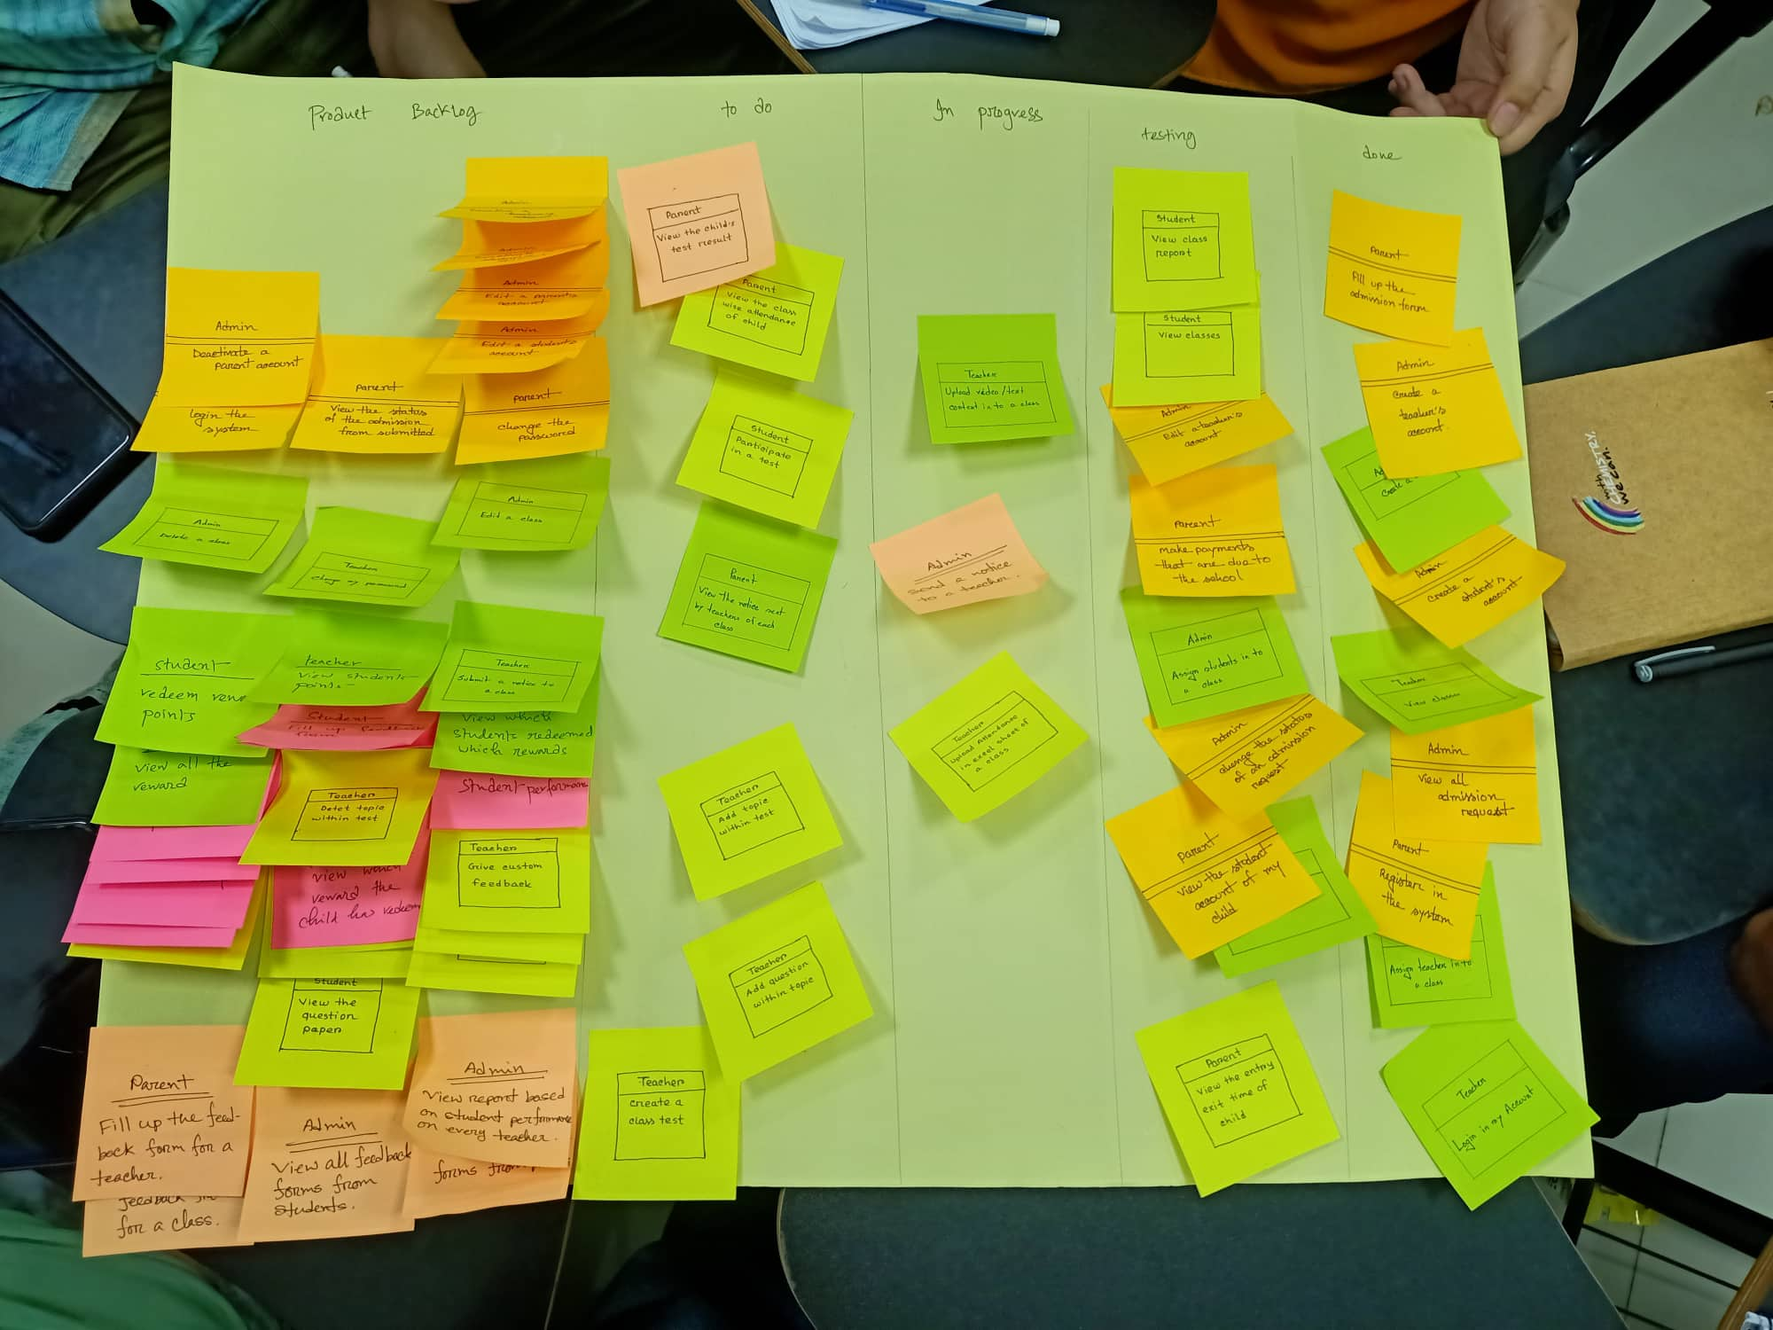
Day 10

Slide 3
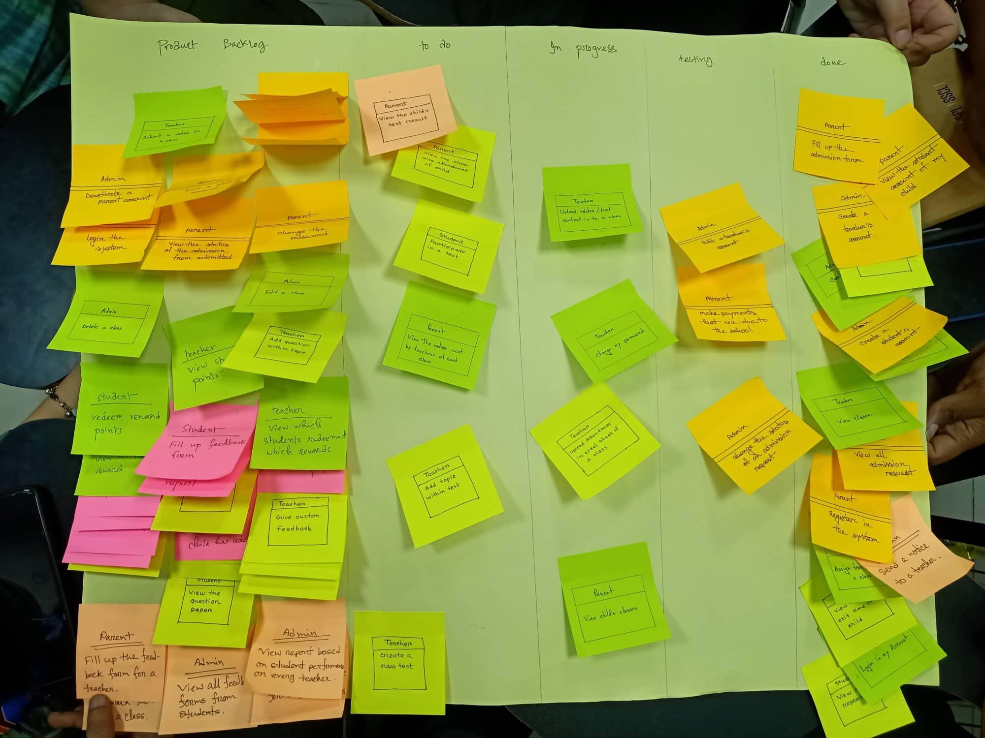
DAY 15

Slide 4
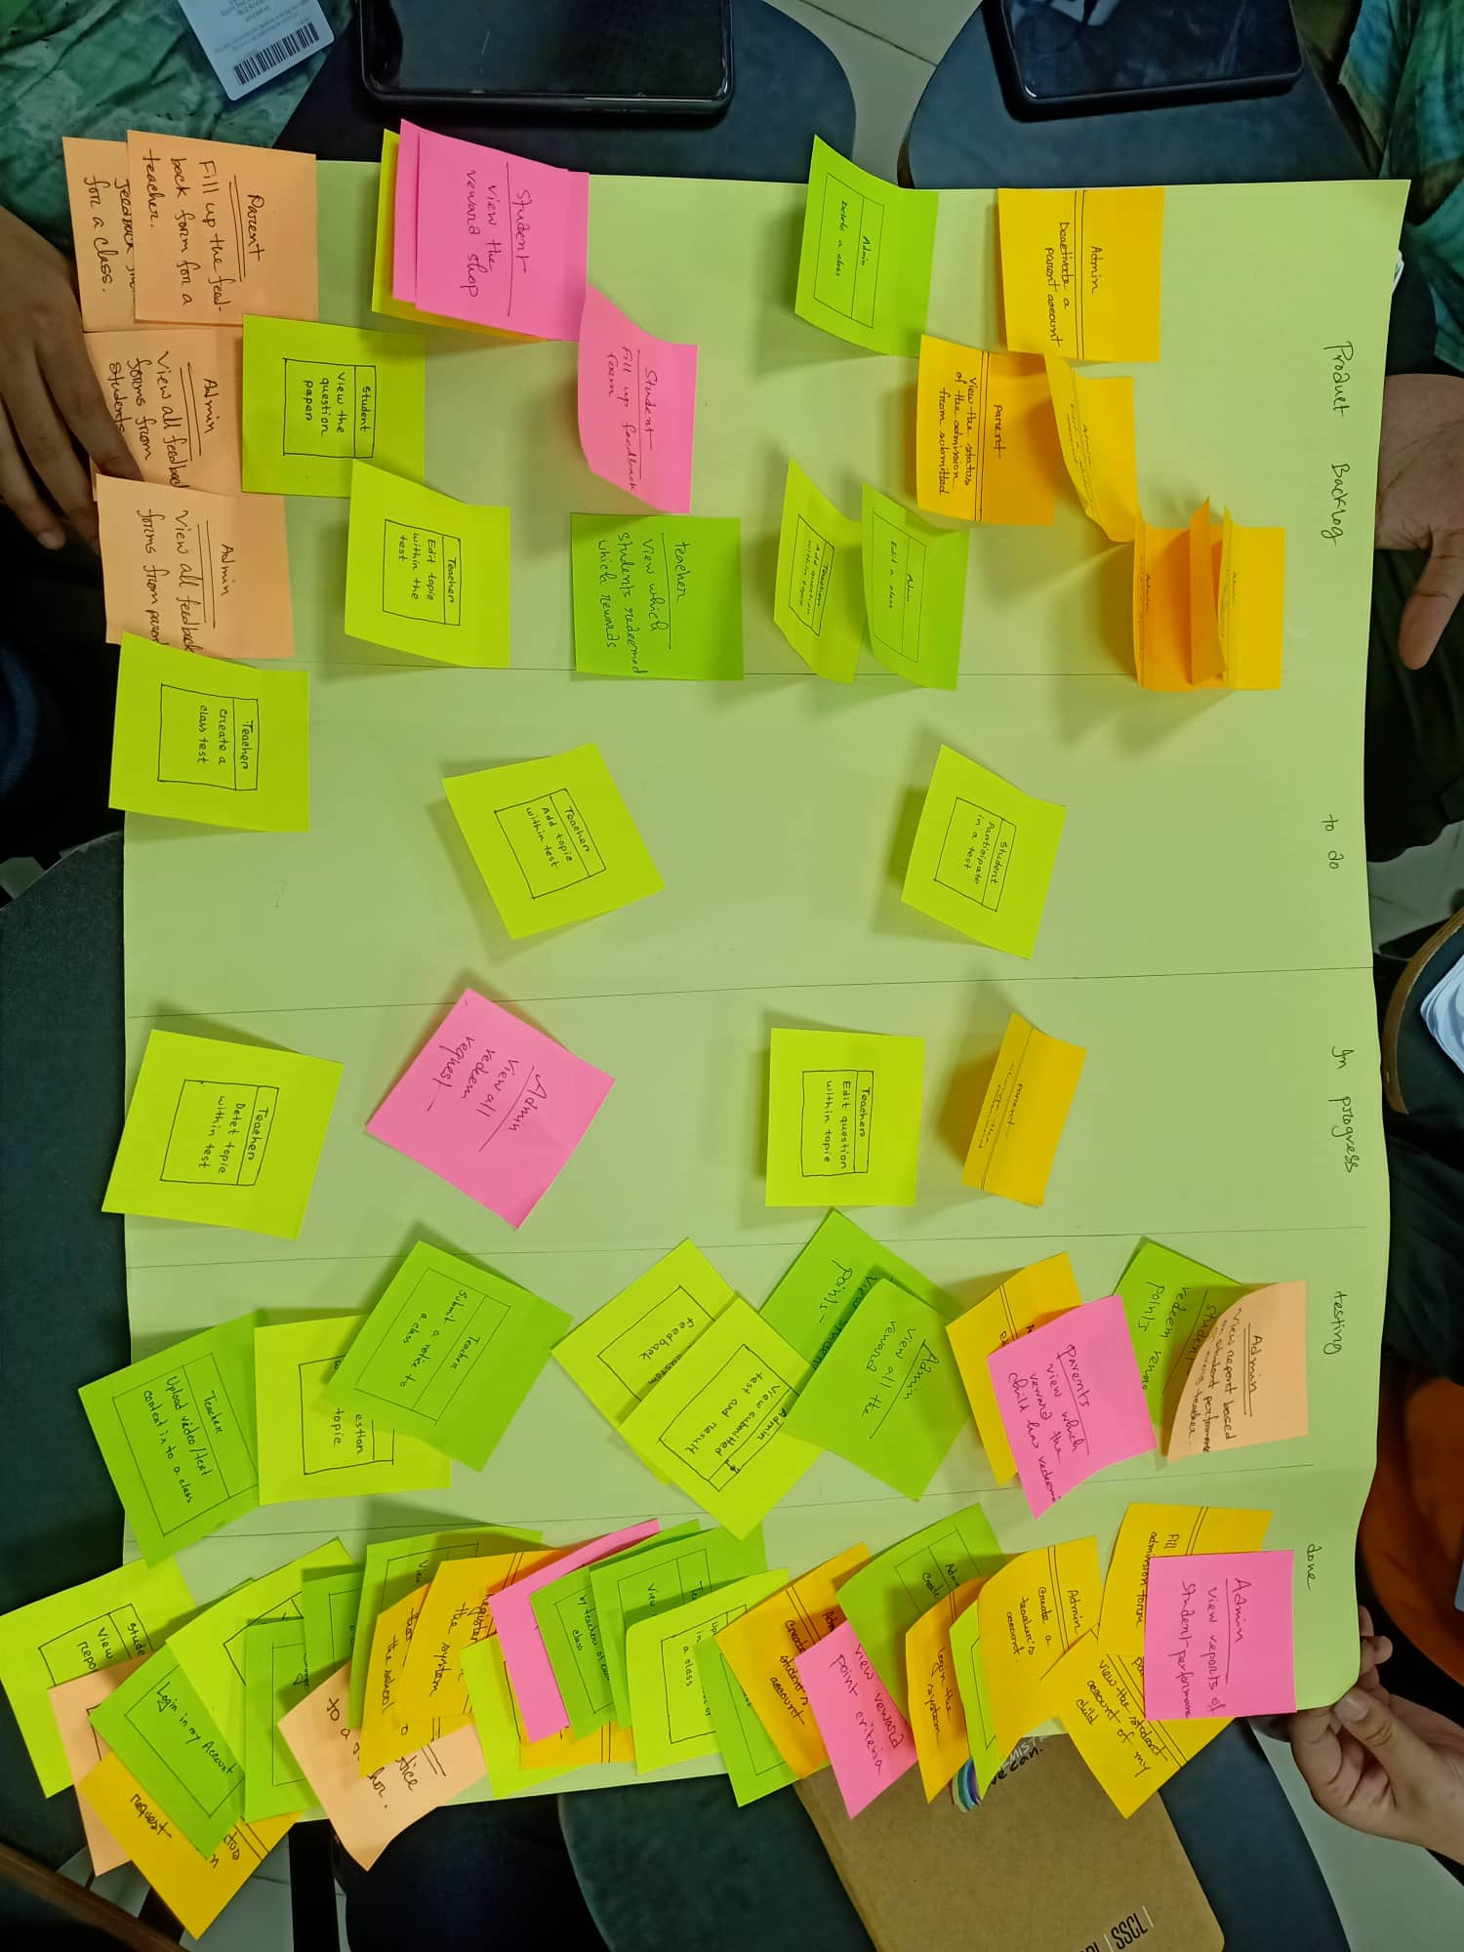
DAY 30

Slide 5
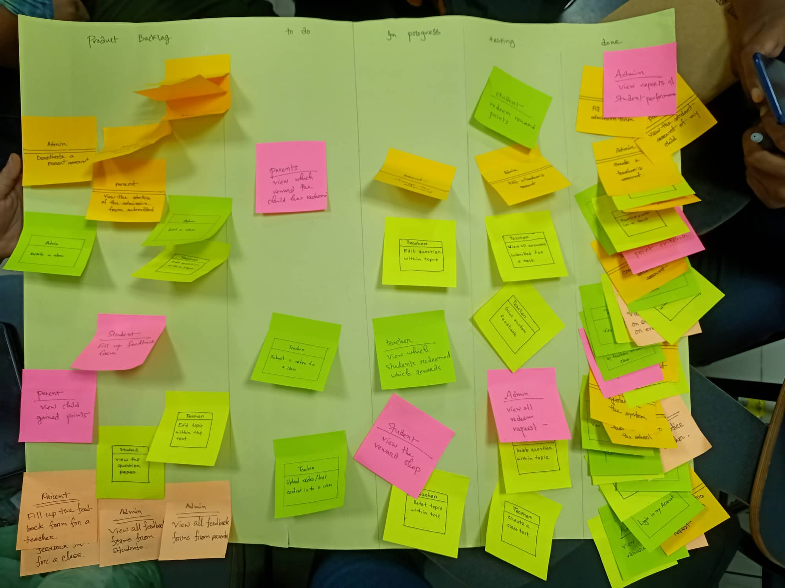
DAY 42

Slide 6
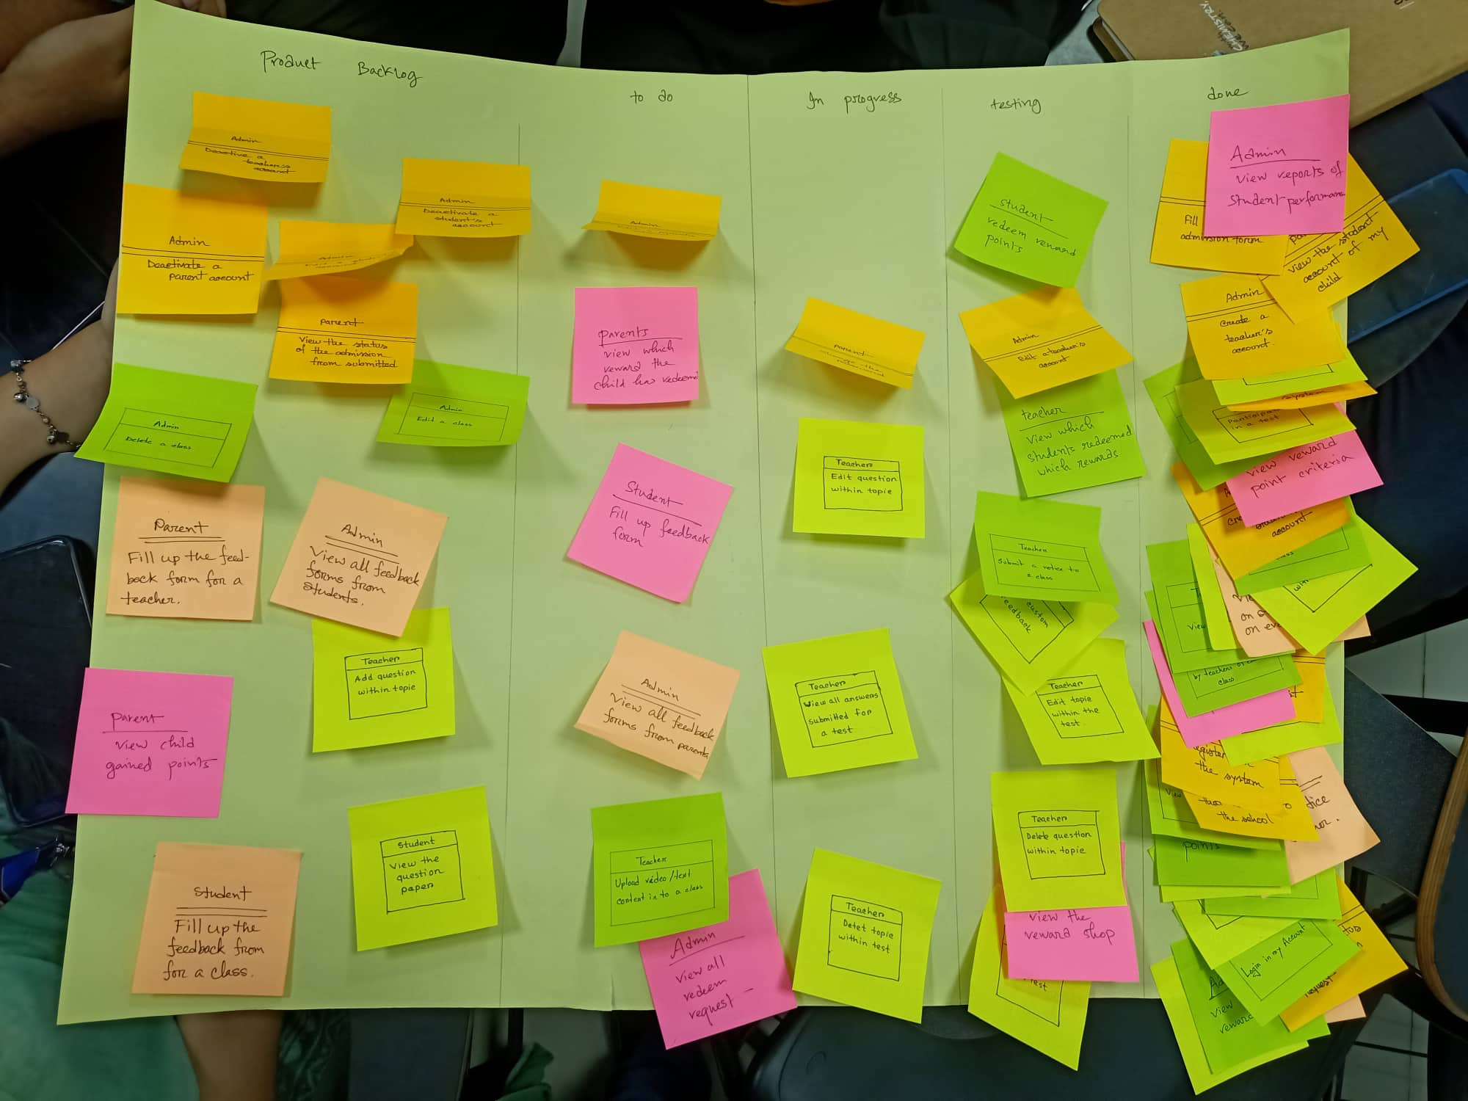
DAY 48

Slide 7
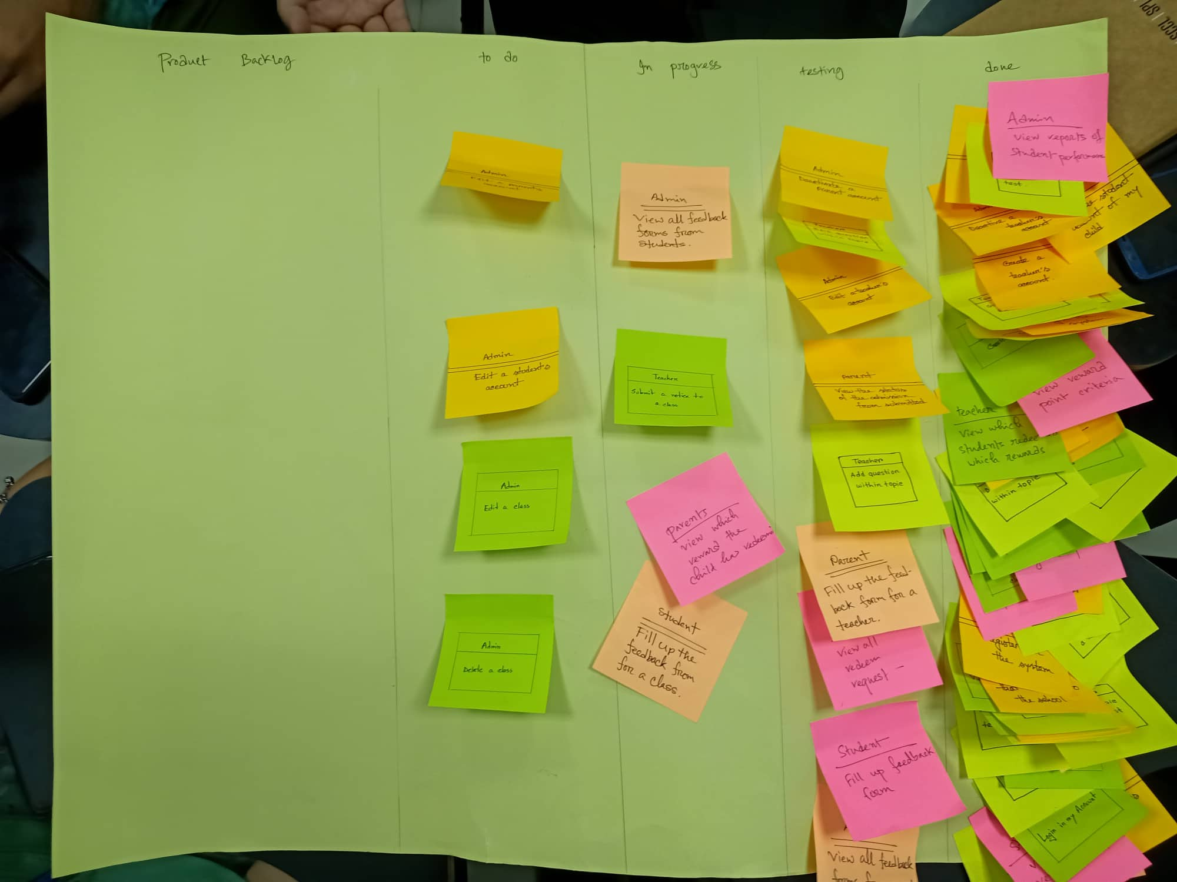
DAY 56

Slide 8
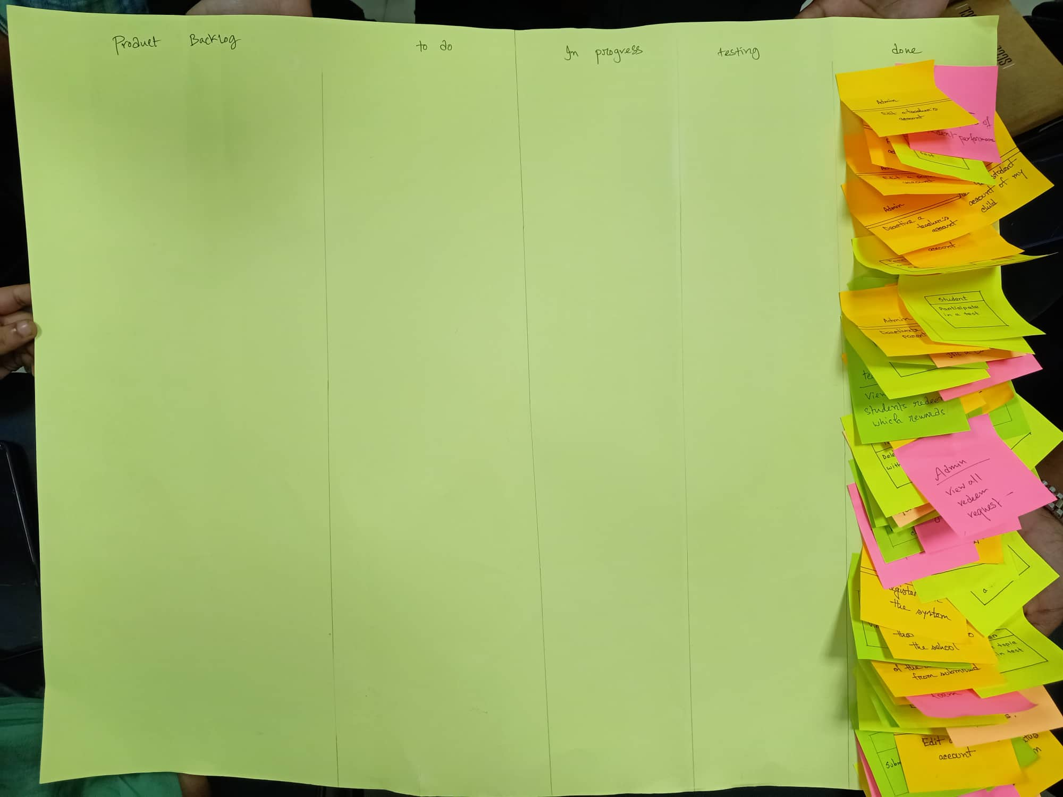
DAY 60

Slide 9
dISCUSSION

Slide 10


